Slide 1
Air Quality Index Prediction
Using Ridge and Lasso Regression
Team: 39
Dhatrika Deekshitha-2520030216

Slide 2
Problem Definition
Problem: Predict AQI using pollutant and weather parameters such as PM2.5, PM10, NO₂, SO₂, CO, O₃, temperature, humidity and wind speed.
Why Important: Accurate AQI prediction helps citizens and authorities take timely preventive actions against air pollution.
Users: Citizens, environmental authorities and pollution-monitoring agencies.
Expected Output: A predicted AQI value from given environmental readings using Ridge/Lasso Regression, with the selected model deployable through a REST API.
01

Slide 3
Dataset Collection
Dataset Source: Kaggle – Air Quality Dataset
Dataset Type: Historical air-quality and meteorological data
Features: PM2.5, PM10, NO₂, SO₂, CO, O₃, Temperature, Humidity, Wind Speed
Target Column: AQI (Air Quality Index)
Dataset Preparation: Dataset downloaded and loaded using Pandas for analysis and preprocessing.
Dataset Size: [Number of Rows] rows × [Number of Columns] columns
Purpose: Use historical environmental data to train Ridge and Lasso Regression models for AQI prediction.
02

Slide 4
Data Understanding
Records: Analyze the total number of rows in the dataset.
Features: PM2.5, PM10, NO₂, SO₂, CO, O₃, Temperature, Humidity & Wind Speed.
Data Types: Check numerical and categorical data types using df.info().
Missing Values: Identify null/missing values in each feature.
Duplicate Values: Check and remove duplicate records if present.
Unique Values: Analyze unique values in important features.
Statistical Summary: Use mean, median, standard deviation, minimum and maximum values.
Feature Distribution: Visualize the distributions of AQI and major pollutants using histograms/box plots.
03

Slide 5
Data Preprocessing
Missing Values: Identify and handle missing values in pollutant and weather features.
Duplicate Records: Detect and remove duplicate observations.
Outliers: Check extreme values in AQI and pollutant features using statistical/visual methods.
Incorrect Data: Identify invalid or inconsistent values and correct/remove them.
Categorical Variables: Identify any categorical columns and encode them if required.
Numerical Variables: Select numerical features such as PM2.5, PM10, NO₂, SO₂, CO, O₃, temperature, humidity, and wind speed.
Feature Scaling: Apply StandardScaler before Ridge/Lasso training so that regularization is applied fairly across features
04

Slide 6
Exploratory Data Analysis (EDA)
Histogram: Analyze the distribution of AQI, PM2.5, PM10 and other pollutants.
Bar Chart: Compare average values of major pollutants.
Box Plot: Detect outliers in AQI and pollutant measurements.
Scatter Plot: Study relationships such as PM2.5 vs AQI.
Correlation Heatmap: Identify relationships between pollutants, weather features and AQI.
Count Plot: Show the frequency of observations across available categories, if categorical variables are present.
05

Slide 7
Feature Selection / Feature Engineering
Features Used: PM2.5, PM10, NO₂, SO₂, CO, O₃, Temperature, Humidity and Wind Speed.
Target: AQI (Air Quality Index).
Features Removed: Any irrelevant/non-predictive columns such as record IDs or unnecessary metadata, if present in the dataset.
Why Removed: They do not contribute meaningful information to AQI prediction and may introduce noise.
Feature Engineering: Numerical features are scaled using StandardScaler before applying Ridge and Lasso Regression.
Feature Selection: Lasso (L1 regularization) can automatically reduce less-important feature coefficients to zero, helping select relevant features
06

Slide 8
Train-Test Split
Training Data – 80%: Used to train the Ridge and Lasso Regression models.
Testing Data – 20%: Kept separate and used to evaluate the model on unseen data.
Input Features: PM2.5, PM10, NO₂, SO₂, CO, O₃, Temperature, Humidity and Wind Speed.
Target: AQI
Purpose: Measure how well the trained model generalizes to new AQI data.
Evaluation Metrics: MAE, RMSE and R²
07

Slide 9
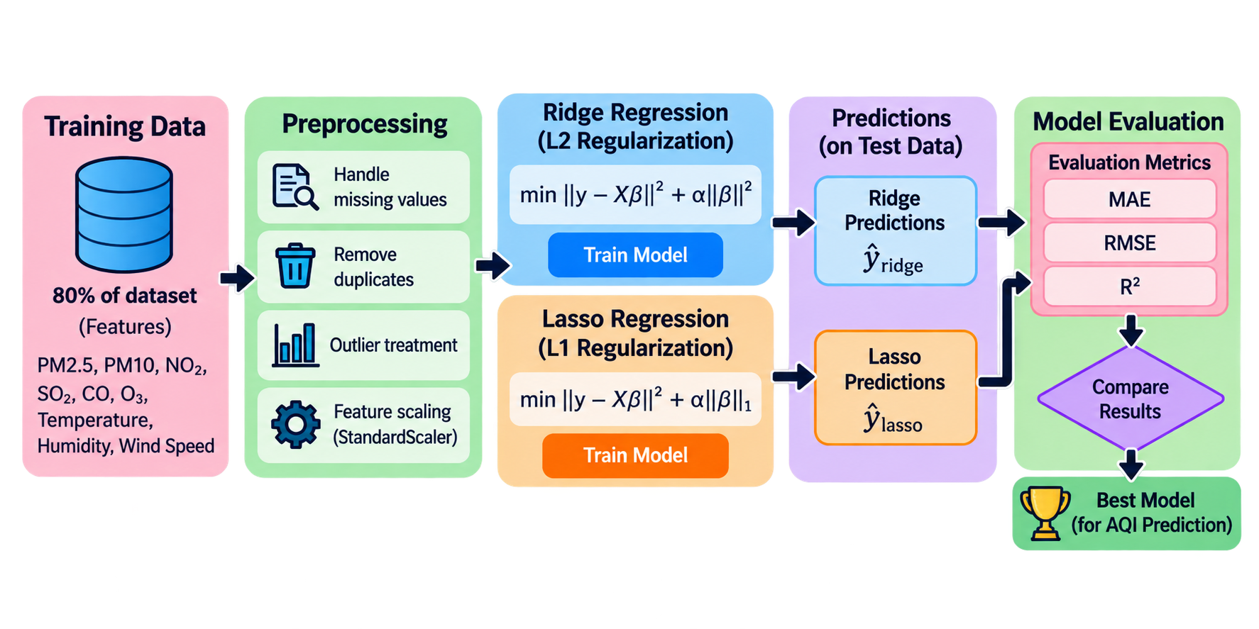
Model Building
08

Slide 10
Model Evaluation
Since your project predicts a continuous AQI value, it is a regression problem, so classification metrics such as Accuracy, Precision, Recall, F1-score, Confusion Matrix and ROC-AUC are not appropriate.
Regression Metrics Used
MAE (Mean Absolute Error): Measures the average absolute prediction error.
RMSE (Root Mean Squared Error): Gives more weight to larger prediction errors.
R² Score: Measures how well the model explains the variation in AQI.
Model Comparison: Compare Ridge vs Lasso using MAE, RMSE and R².
Goal: Select the model with lower prediction errors and stronger R² performance.
09

Slide 11
THANK YOU
10

